Slide 1
Behind The Gesture

Slide 2
Abstract

Slide 3
Sign language is a way by which deaf and dumb people can express their thoughts and feelings.
Deaf and dumb people use hand shape, body movements, and facial expressions for communication.
In this work, a vision-based Indian Sign Language Recognition system using a Convolutional Neural Network (CNN) is implemented.
The sign images are captured by a web camera.

Slide 4
This behind the gesture project was a system based application.
To segment the hand region, background subtraction method is used.
Two datasets have been created for Behind the gesture.
Each of the datasets contains 26 alphabets having a total of 6,500 images.
And it has been named as test_set and training_set.

Slide 5
The system has also been tested in real time, where the sign alphabets by me and my friend in front of the camera are captured and it correctly recognizes almost all of the signs.
Accuracy of around 99.40% is obtained.

Slide 6
Proposed System

Slide 7
The purpose of the system is to improve the existing system in this area in terms of response time and accuracy with the use of efficient algorithms, high quality datasets.
The existing systems have been able to recognize gestures with high latency as it uses only image processing.
In our project we aim to develop a cognitive system which would be responsive and robust so as to be used in day to day applications by hearing and speech disabled people.

Slide 8
DISADVANTAGES
No comparison is made between the accuracies of several algorithm
The overall classification accuracy was found to be the same irrespective of the kernel types.
Occurrence of errors are more in single Feed Forward Neural Network with large no. of hidden neurons Processing building the model requires fast and efficient
processors which is cost consuming.

Slide 9
Existing System

Slide 10
Compared to other projects they are not in a live sign, gestures would not be processed. That system is to not improve the response time.
And accuracy with the use of lots of hard to understand algorithms, inaccurate datasets.
It’s difficult to understand for the users because of not having proper guidance/ instructions on how to use that system.

Slide 11
ADVANTAGES
High performance.
Convolutional Neural Network is used to find the accuracy more reliable.

Slide 12
System Specification

Slide 13
Software Specification:
● OS: Windows 10
● Language used: Python
Visual studio code
Python idle (3.10.3)
Hardware Specification:
● System: Intel i3 processor
● Hard Disk: 1TB
● Mouse: Logitech
● Keyboard: 110 keys enhanced
● Ram: 4GB.
Tools / packages Used:
1. Python 3
2. OpenCV 3
3. Tensorflow
4. Keras

Slide 14
System Architecture

Slide 15
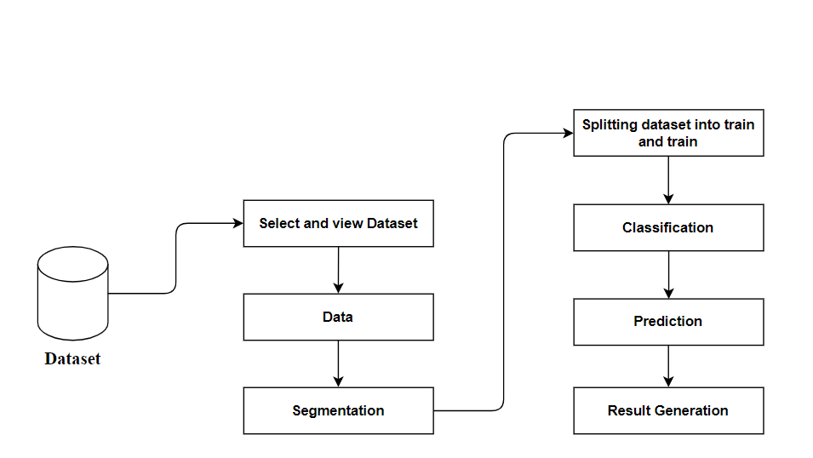

Slide 16
Use case System

Slide 17
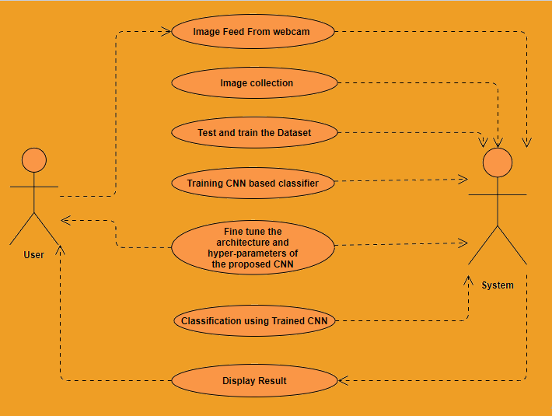

Slide 18
Data flow Diagram

Slide 19
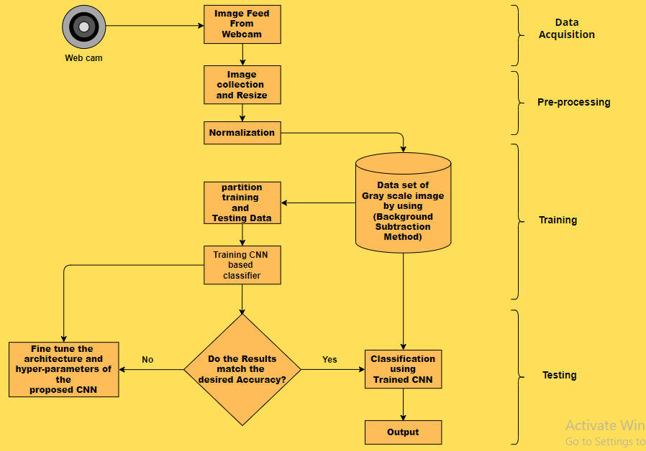

Slide 20
State Mission Diagram

Slide 21
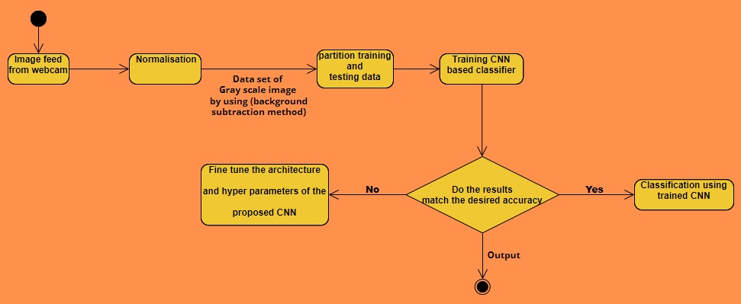

Slide 22
Entity Relationship Diagram

Slide 23
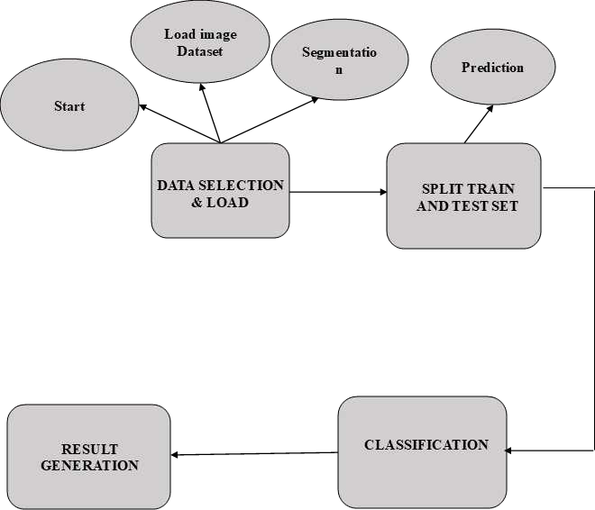

Slide 24
Sequence Diagram

Slide 25
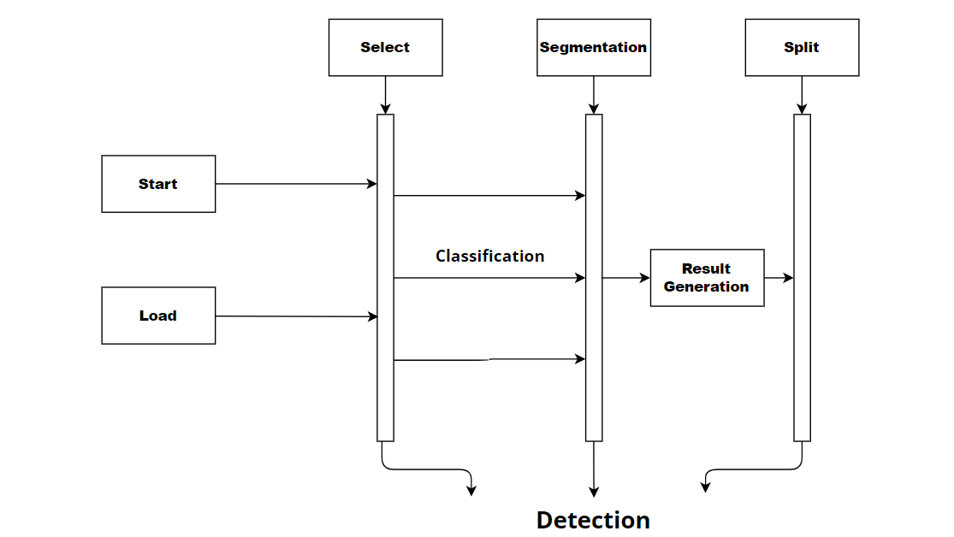

Slide 26
MODULES WITH DESCRIPTION

Slide 27
Data Selection and Loading
Data Preprocessing
Segmentation
Splitting Dataset into Train and Test Data
Classification
Prediction
Result Generation

Slide 28
Data Selection and Loading
* The data selection is the process of selecting the data to detect the Gestures.
* In this project, the fire dataset is used for predicting Gestures.
* The dataset which contains the information about the hand gestures with corresponding trained and test images.

Slide 29
Data Preprocessing
Image Data pre-processing is the process of getting rescale data from the dataset.
Resize image dataset
Getting data
Resize image dataset: Rescale the hand gesture image size.
Getting data: That categorical data is defined as variables with a finite set of rescaled values. Most deep learning algorithms require array input and output variables.

Slide 30
Segmentation
In digital image processing and computer vision, image segmentation is the process of partitioning a digital image into multiple segments (sets of pixels, also known as image objects). The goal of segmentation is to simplify and/or change the representation of an image into something that is more meaningful and easier to analyze. Image segmentation is typically used to locate objects and boundaries (Lines, curves, etc.) in images. More precisely, image segmentation is the process of assigning a label to every pixel in an image such that pixels with the same label share certain characteristics.

Slide 31
The result of image segmentation is a set of segments that collectively cover the entire image, or a set of contours extracted from the image (see edge detection). Each of the pixels in a region are similar with respect to some characteristic or computed property, such as color, intensity, or texture. Adjacent regions are significantly different with respect to the same characteristic(s). When applied to a stack of images, typical in medical imaging, the resulting contours after image segmentation can be used to create 3D reconstructions with the help of interpolation algorithms like marching cubes.

Slide 32
Splitting Dataset into Train and Test Data
Data splitting is the act of partitioning available data into. Two portions, usually for cross-validators purposes.
One portion of the data is used to develop a predictive model and the other to evaluate the model's performance.
Separating data into training and testing sets is an important part of evaluating data mining models.
Typically, when you separate a data set into a training set and testing set, most of the data is used for training, and a smaller portion of the data is used for testing.

Slide 33
Classification
Image Classification is the task of assigning an input image, one label from a fixed set of categories. This is one of the core problems in Computer Vision that, despite its simplicity, has a large variety of practical applications.
Let’s take an example to better understand. When we perform image classification our system will receive an image as input, for example, a Cat. Now the system will be aware of a set of categories and its goal is to assign a category to the image.

Slide 34
This problem might seem simple or easy but it is a very hard problem for the computer to solve. As you might know, the computer sees a grid of numbers and not the image of a cat as how we see it. Images are 3-dimensional arrays of integers from 0 to 255, of size Width x Height x 3. The 3 represents the three color channels Red, Green, Blue.
So how can our system learn to identify this image? By using Convolutional Neural Networks. Convolutional neural networks or CNN’s are a class of deep learning neural networks that are a huge breakthrough in image recognition. You might have a basic understanding of CNN’s by now, and we know CNN’s consist of convolutional layers, Relu layers, Pooling layers, and Fully connected dense layers.

Slide 35
Prediction
It’s a process of hand gesture from the dataset.
This project will effectively detect the data from the dataset by
enhancing the performance of the overall prediction results.
RESULT GENERATION
The Final Result will get generated based on the overall classification and prediction. The performance of this proposed approach is evaluated using some measures.

Slide 36
CONCLUSION AND
FUTURE ENHANCEMENTS

Slide 37
With this complete work, we have studied and learnt various models of CNN and image processing which can be used to image classification further. We used a dataset of almost 6500 images from various sources (included in references) and also performed with our own datasets. We implemented using different python modules and libraries for calculations and categorized them into respective classes. We used a keras module for model building called sequential model, and added layers of CNN with its activation function. The best part of this CNN is we can know the accuracy and the variable loss for each digit while running the algorithm and we can plot the images. By using softmax activation, it can be used for multi class distribution to recognize the gesture to which class it belongs to. Finally, we will show the output as the text of the digit predicted and display it on the screen.
Future work:
We conclude that this model can be improved by using good light conditions and a better camera for good performance and also, we plan to make this model predict the alphabets for its respective gesture according to Indian Sign Language.

Slide 38
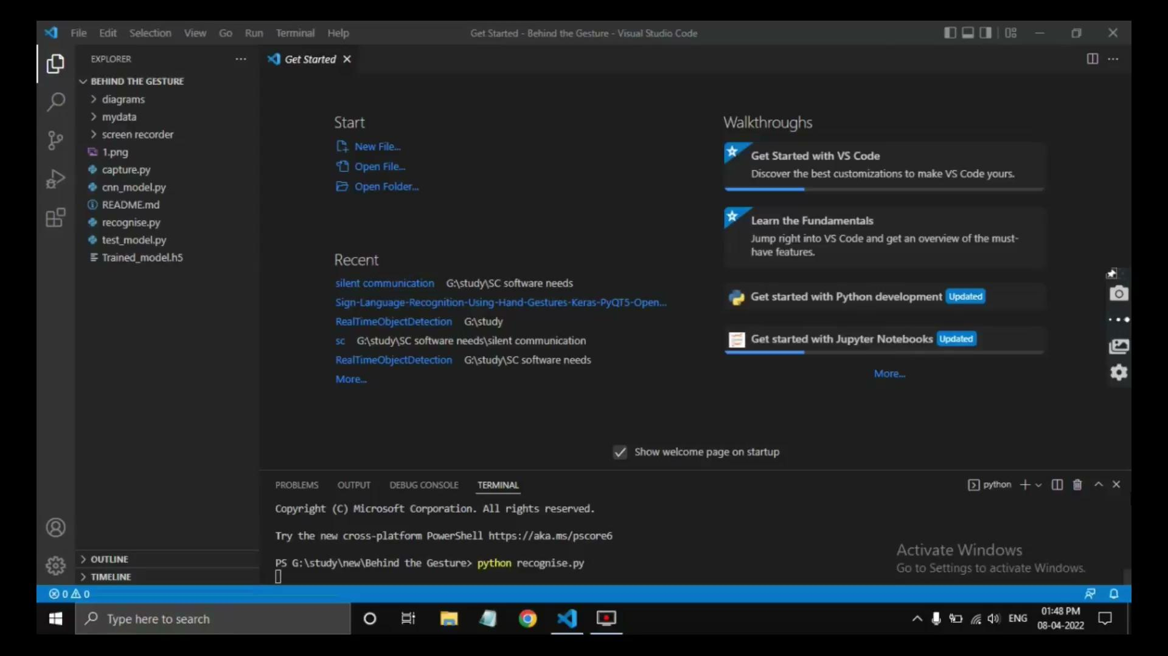

Slide 39
Thank you
K.mongia
(19MCA36)

